Slide 1
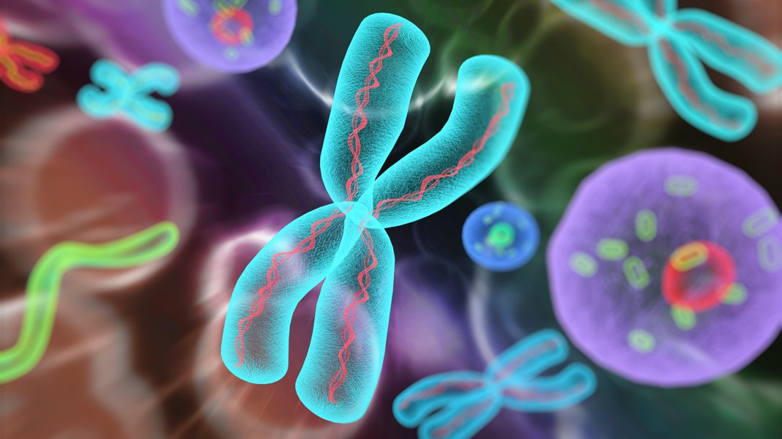
The Advantage of Bioinformatics-Enabled
Design & Synthesis of Pinpoint FISH™ Probes
KromaTiD Overview
Synthetic Oligo Probe Design and Manufacturing
Pinpoint FISH™ Probes and Applications
Customizing the Design Process
Ordering Pinpoint FISH Probes
Presented by Ivan Perez | Technical Applications Scientist, KromaTiD

Slide 2
Overview of KromaTiD
KromaTiD is staffed by a committed team specializing in delivering top-tier genomic tools and services.
Located in Longmont, Colorado, our primary mission is to offer the tools and assistance required to propel the progress of genomic medicine and research.
www.kromatid.com
Notes:
KromaTiD is based in Longmont, Colorado, just outside of Boulder.
We are a research-focused team, committed to providing you with top-tier tools and expertise to advance your scientific goals.
We work with scientists in academic institutions, in large pharmaceutical companies, and within governmental settings.

Slide 3
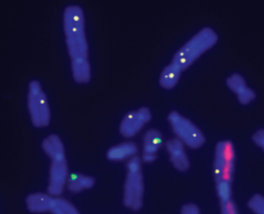
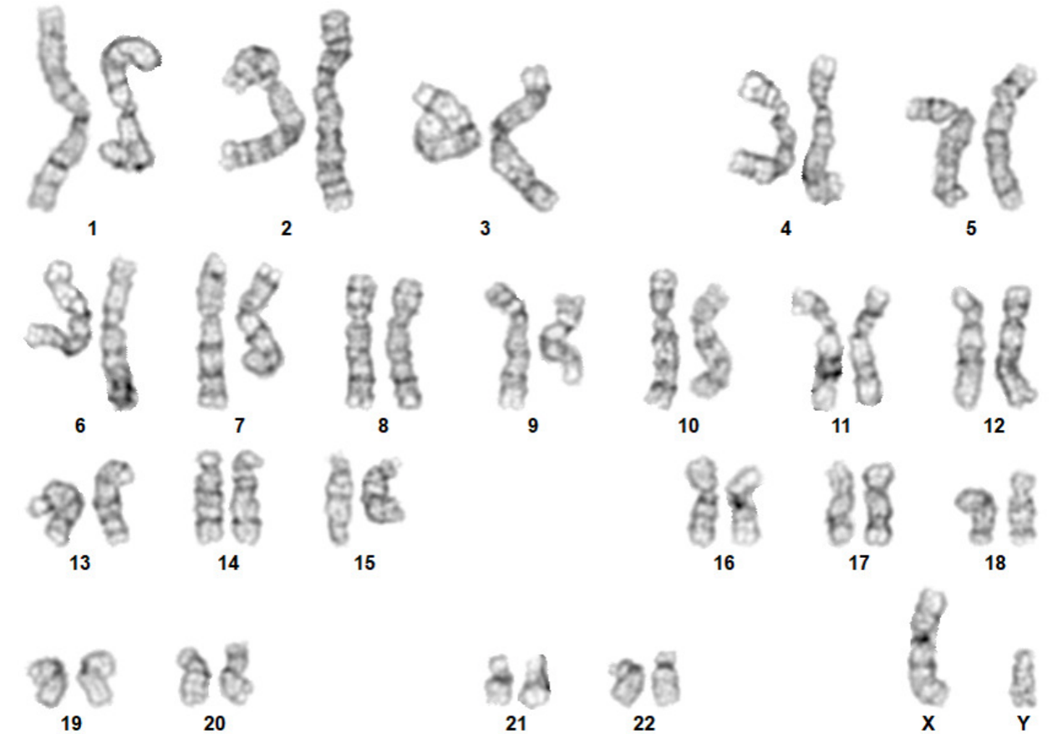
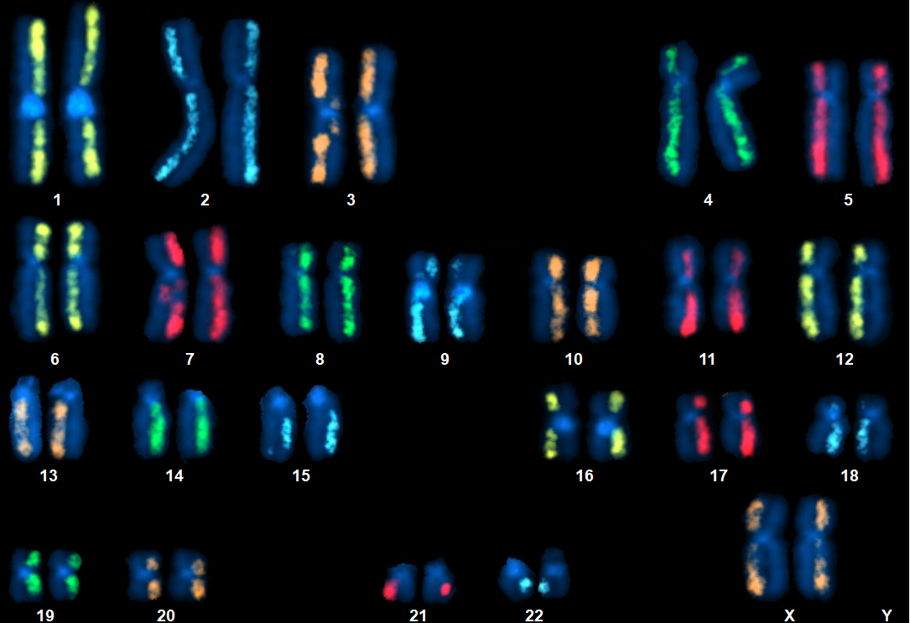
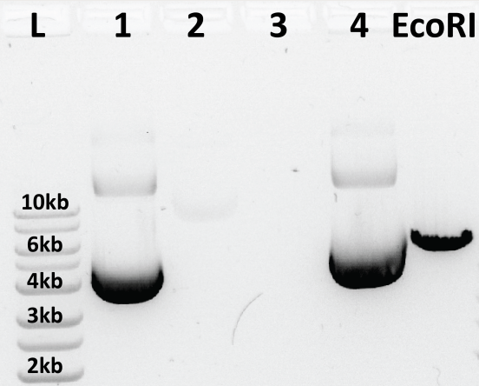
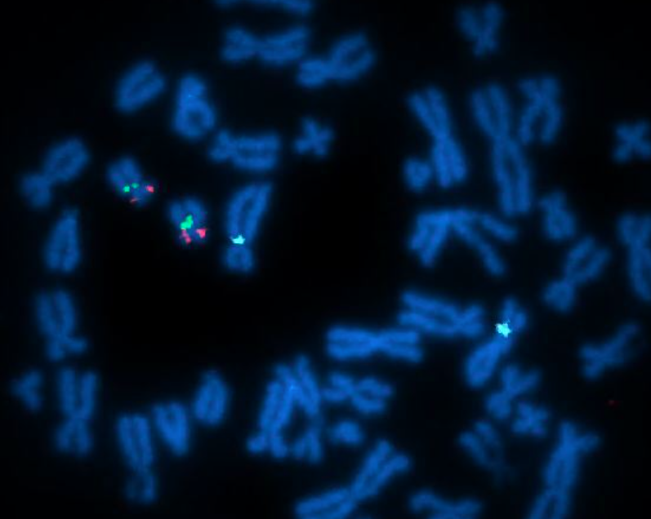
KromaTiD Offers Unique Products and Services
dGH in-Site™
G-Banding
dGH SCREEN™
Plasmid Manufacturing
Pinpoint FISH™
KromaTiD provides a molecular toolkit which gives scientists unmatched insight into gene editing outcomes, indicators of genomic instability, and disease biomarkers.
www.kromatid.com
Notes:
KromaTiD supports the scientific community with a wide range of genomics tools, from custom probes, to plasmids, to a sophisticated set of proprietary assays. We deliver the solutions investigators need, from the research stage to commercial applications.

Slide 4
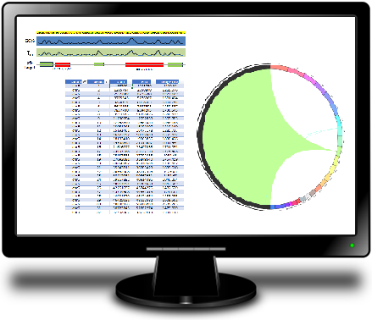
Human Genome Project and Bioinformatics Design
The HGP was completed in April 2003.
The genome can be mined for candidate sequences meeting key requirements:
Target binding strength: GC%, T_{m}, length, …
Uniqueness: Alignment and masking algorithms
Interactions: Screening for hairpin loops, dimers, …
Probes can be designed against any published non-human genomes too.
www.kromatid.com
Notes:
The completion of the Human Genome Project facilitated the algorithmic search for sequences suitable for use as FISH probes.
Using this bioinformatic approach, candidate sequences can be identified en masse.
Undesirable sequences can be screened-out, for instance, if they may bind off-target or form unwanted structures.
As reference genomes are published for more and more species, probes can be designed against those too.

Slide 5
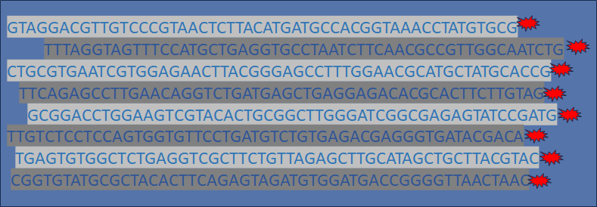
Streamlined Manufacturing Process: Synthesis and Labeling of Pinpoint FISH™ Probes
In Silico Design
Fluorescently Labeled Oligonucleotides
Selected sequences are synthesized, amplified and fluorescently labeled.
Reduced hands-on time during manufacturing lowers cost for the user.
www.kromatid.com
Notes:
Traditionally, FISH probe sets have been created using bacterial artificial chromosome (BAC) libraries.
Transitioning to a fully synthetic manufacturing approach allows for greater automation, lower costs, and more predictable outcomes.
Designing for a new species no longer requires the labor of building a new BAC library; one simply downloads the new reference genome.
This is why KromaTiD can supply probes for any mammalian species, despite possessing no BAC libraries.
Automated platforms cover each stage of the process – DNA synthesis, amplification, and fluorescent labeling.
Users benefit from greater options, financial savings and improved product performance.

Slide 6
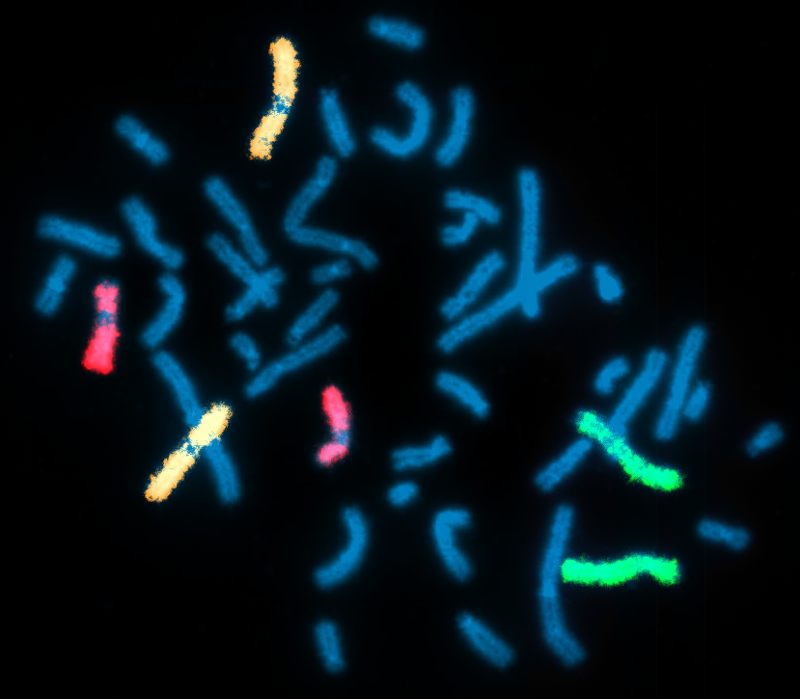
Benefits of Synthetic Oligonucleotide Pinpoint FISH™ Probes
Superior Signal-to-Noise Ratio: Off-target binding eliminated algorithmically and confirmed through experimental QC testing post-manufacturing.
High Resolution: High signal-to-noise ratio allows visualization of very small targets. (<5 kb)
Reduced Cost: Manufacturing is more streamlined.
Tailored Designs: Bioinformatic design customization can address unique research needs.
HD chromosome paints multiplex targeting chromosome 3 (orange), chromosome 4 (green), and chromosome 7 (red) in immortalized human leukocyte control cell line.
www.kromatid.com
Notes:
The benefits of the synthetic oligonucleotide approach include an excellent signal-to-noise ratio from the pre- and post-manufacturing quality control steps.
That resulting low background noise means the limit of detection goes down, so probe sets can be designed against smaller targets that wouldn’t be resolvable otherwise. KromaTiD routinely designs against single-digit kilobase targets.
Manufacturing costs are reduced, and probes can be more easily tailored to the researcher’s needs.

Slide 7
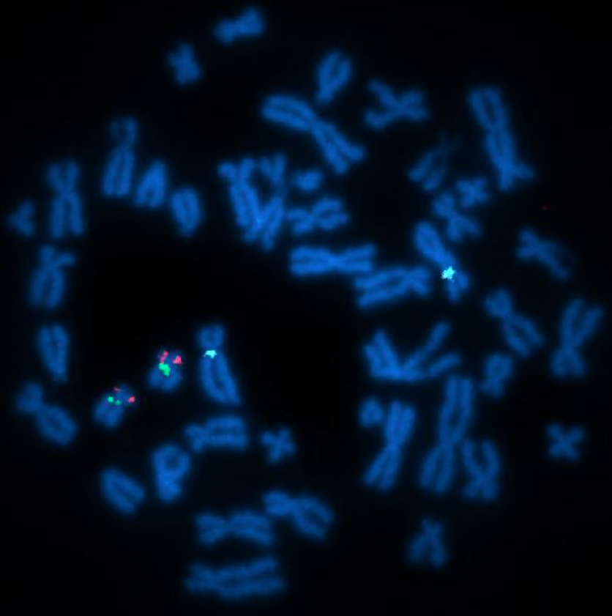
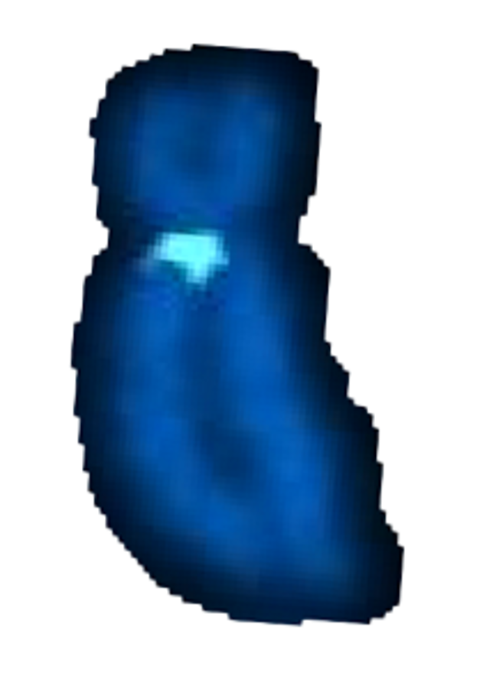
Subcentromeric Pinpoint FISH™ Probes
Subcentromere Probes
Probe category targeting arm-specific, pericentric genomic DNA
Applications
Centromere enumeration
Control signal in multiplex
Detection of rearrangements at target locus
Translocations
Inversions
Complex rearrangements
Chr 5q
subcentromere
Chromosome 5q subcentromere probe (aqua) in multiplex hybridization with KromaTiD’s TP53/CEP17 kit in human control metaphase spread.
www.kromatid.com
Notes:
We’ll now look at some of the design strategies used in KromaTiD’s Pinpoint FISH probes.
The subcentromere probes target unique sequence loci adjacent to the centromere.
This is in contrast to many centromere enumeration probes, which target the repetitive DNA regions within the centromeric space.
The subcentromeric approach confers two advantages: a high signal-to-noise ratio despite using no repetitive DNA blocker, and the data being arm-specific.
Thanks to the bioinformatic design methods employed, all Pinpoint FISH probes can be freely multiplexed.
In the image seen here, KromaTiD’s TP53/CEP17 kit (the red and green signals) targets loci on chromosome 17, while an additional subcentromeric probe in aqua targets chromosome 5.
This combination can reveal when TP53 deletions are accompanied by chromosome 5 monosomy in the same cell, data with high prognostic value.

Slide 8
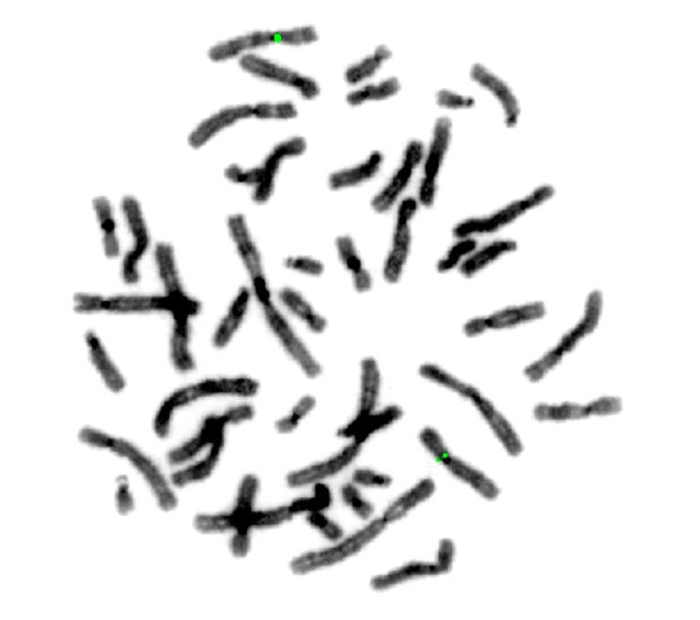
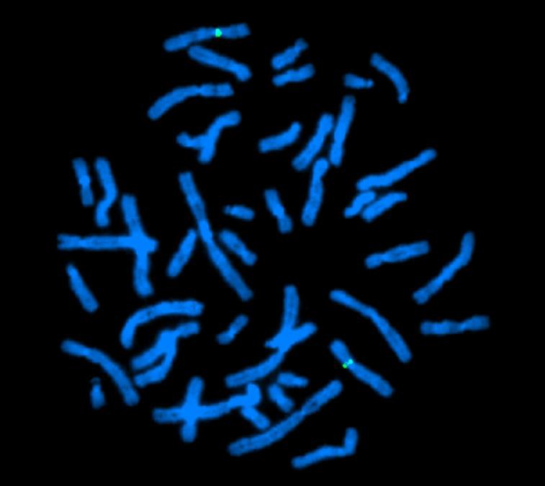
Chromosome 7p Subcentromere Probe
www.kromatid.com
Notes:
Here is another example of one of the subcentromere probes, this time targeting the p-arm side of chromosome 7.
The inverted DAPI image on the left and in the lower center helps create a simulated G-band staining pattern.

Slide 9
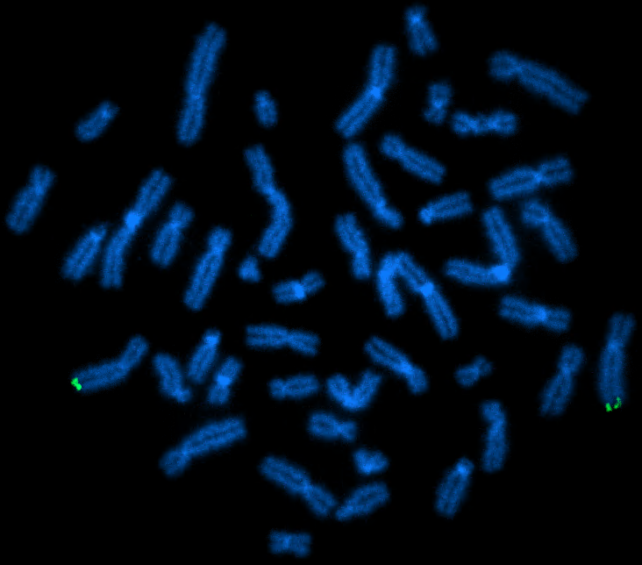
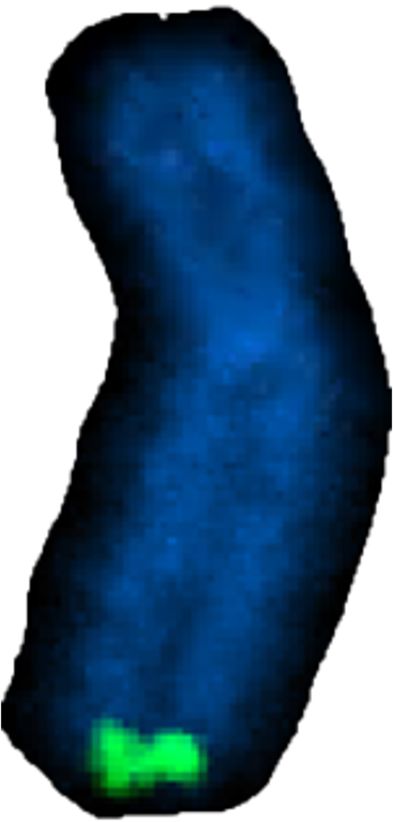
Subtelomeric Pinpoint FISH™ Probes
Subtelomere Probes:
Probe category targeting arm-specific, peritelomeric genomic DNA
Applications:
Chromosome enumeration
Control signal in multiplex
Detection of rearrangements at target locus
Any terminal deletion
Translocations
Complex rearrangements Generate arm-specific data
Chr 6q
subtelomere
Chromosome 6q subtelomere probe (green) hybridized in human control metaphase spread.
www.kromatid.com
Notes:
Like subcentromere probes, subtelomere probes target genomic DNA, this time adjacent to the repetitive sequences of the telomeres.
Subtelomere probes also serve as reference signals in multiplex hybridizations.
They are ideal for detecting terminal deletions, as well as other rearrangements affecting the terminus.

Slide 10
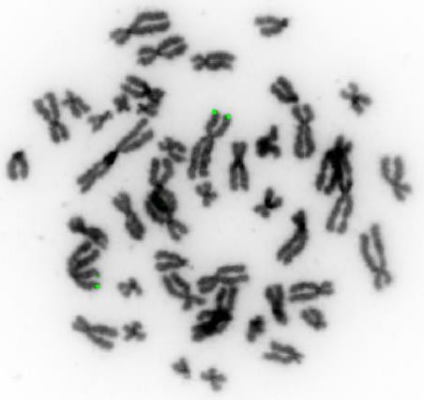
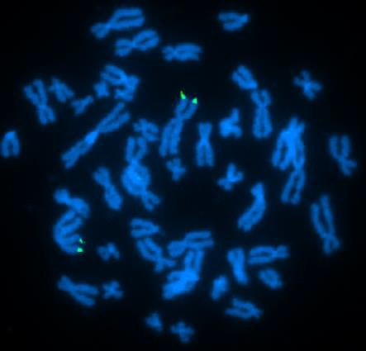
Subtelomeric Pinpoint FISH™ Probes
www.kromatid.com
Notes:
Here again is a second example, this subtelomere probe targets near the p-arm terminus of chromosome 2.
Again, the inverted DAPI image on the left and in the lower-center creates that simulated G-band staining pattern.
The examples shown for both the subcentromere and subtelomere probes have been metaphase images, but users apply these probes in interphase studies regularly.
We have a minimum oligonucleotides-per-kilobase limit for standard designs, which ensures probe sets reliably generate nice, bright, compact signals in interphase nuclei as well as in metaphase.

Slide 11
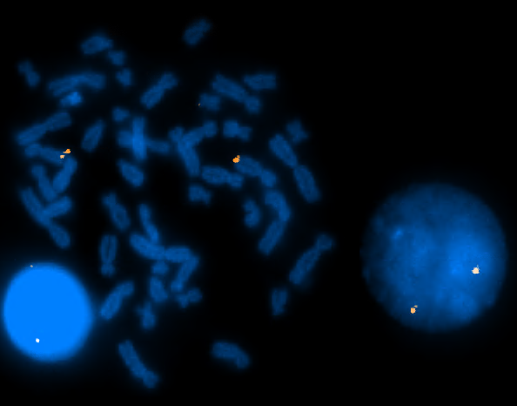
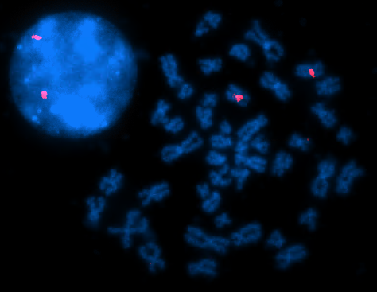
Pinpoint FISH™ Metaphase-Interphase Examples
(Left) Q-arm subcentromere probe for chromosome X labeled in red.
(Right) Q-arm subtelomere probe for chromosome 7 labeled in orange.
www.kromatid.com
Notes:
Here are two example images showing interphase nuclei and metaphase spread pairings for a probe from each of the two categories discussed.
The left-hand image features the q-arm subcentromere probe for chromosome X labeled in red and the image on the right corresponds to the subtelomere probe for the q-arm of chromosome 7 labeled in orange.

Slide 12
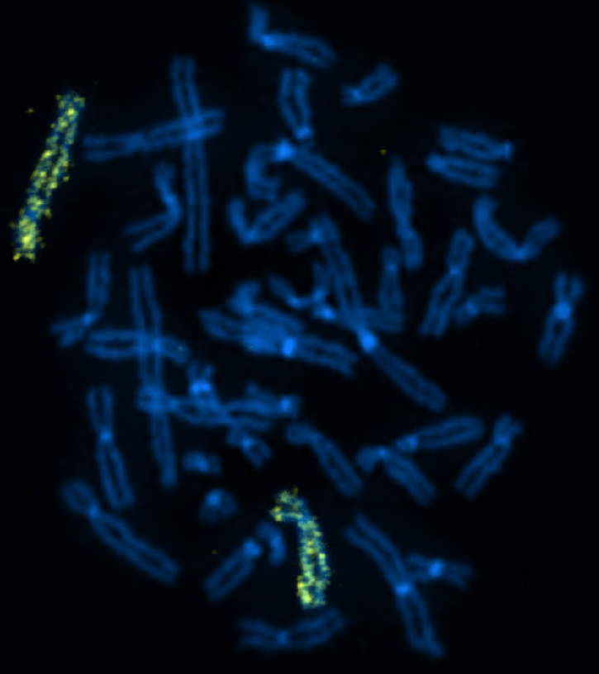
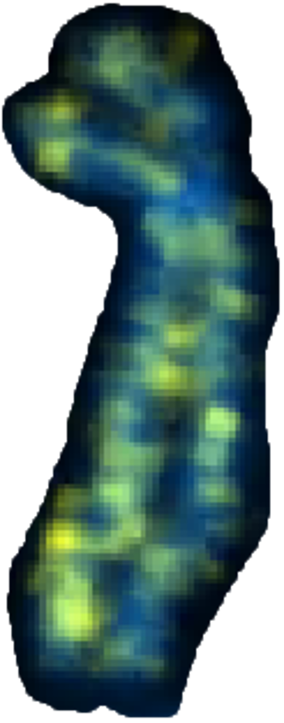
MD Whole Chromosome Paints
Medium-Density (MD) Paints
Probe category targeting a patchwork of loci along the length of the chromosome, resulting in an interspersed signal pattern.
Applications
Recommended for metaphase studies
Detection of aneuploidy
Detection of polyploidy, by multiplexing multiple paints at once
Detection of structural rearrangements
Chr 4
MD paint
Chromosome 4 Medium-Density Paint (yellow) hybridized in human control metaphase spread.
www.kromatid.com
Notes:
Transitioning to whole chromosome paints, the first category we’re going to look at is the medium-density or MD paint probe family.
MD paints perform best in metaphase studies.
Targeted loci along the length of the chromosome are spaced out in this design, reducing material costs during manufacturing and lowering the product’s price.
These probes serve to locate and enumerate the target chromosome, revealing numerical abnormalities like aneuploidy and polyploidy.
Translocations are detected as well, with fluorescence following the relocated labeled DNA.

Slide 13
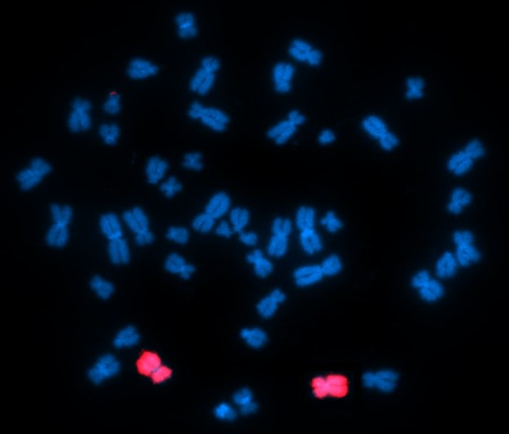
HD Whole Chromosome Paints
High-Density (HD) Paints
Probe category targeting all qualifying unique-sequence loci along the length of the chromosome, resulting in blanket fluorescence.
Applications
For both interphase and metaphase studies
Detection of aneuploidy
Detection of polyploidy by multiplexing multiple paints at once
Detection of structural rearrangements
Spatial localization of unwound chromatin within nuclei
Chr 11
HD paint
Chromosome 11 High-Density Paint (red) hybridized in human control metaphase spread.
www.kromatid.com
Notes:
The high-density, HD paints have no coverage gaps and target all compatible unique sequence loci, resulting in blanket fluorescence.
The HD paint probes perform well in either metaphase or interphase.
They are suited to any application requiring:
chromosome enumeration,
detection of structural rearrangements,
and characterization of the spatial distribution of unwound chromatin within interphase nuclei.

Slide 14
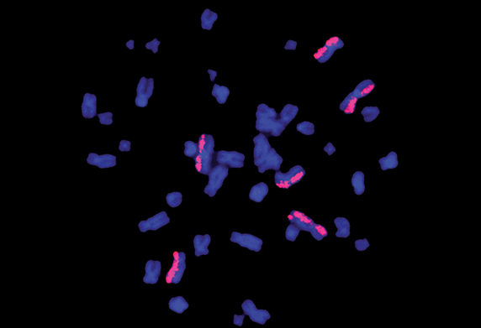
Use Case: NASA ”Twin’s Study” HD Chromosome Paints
KromaTiD work with NASA in the “Twins Study”
Assay of DNA damage from radiation in Space.
KromaTiD continues to work with NASA.
Fluorescent Paints Spot DNA Damage from Radiation, Gene Editing. (2019). Retrieved from https://spinoff.nasa.gov/Spinoff2019/hm_3.html
www.kromatid.com
Notes:
One exciting application of the HD paints is the role KromaTiD played as part of the NASA Twins Study.
Identical twin astronauts, Scott and Mark Kelly were studied over the course of one year while one was in orbit and the other was here on the surface.
NASA scientists needed a better way to track DNA damage suffered through exposure to the ionizing radiation of Space.
The high-density paints enabled the space agency to compare the incidence of structural rearrangements and other changes seen in the DNA of both subjects.
KromaTiD continues to work with NASA, in collaboration with Dr. Susan Bailey at Colorado State University.

Slide 15
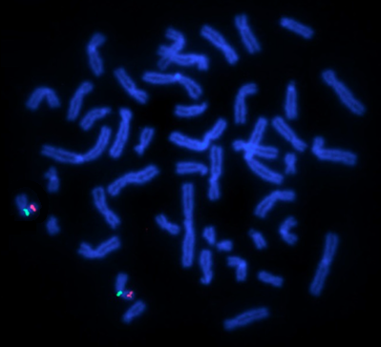
Gene Target Probes
Featured: TP53/CEP17
Multiplex probe kit designed to target TP53 gene region and pericentromeric q-arm of chromosome 17.
Applications
Detecting deletion of TP53 gene region
Characterizing other rearrangement events involving the two target loci
Translocations
Inversions
Complex rearrangements
TP53 (red) and chr17q subcentromere (green) probes hybridized in human control metaphase spread.
www.kromatid.com
Notes:
When targeting genes, the bioinformatic design approach enables inventive customizations.
A designer can knowingly include specific gene expression elements or break up a target region into segments to be labeled according to a strategic color scheme.
Designs can thus be tailored so they answer unique scientific questions which would be difficult to address otherwise.

Slide 16
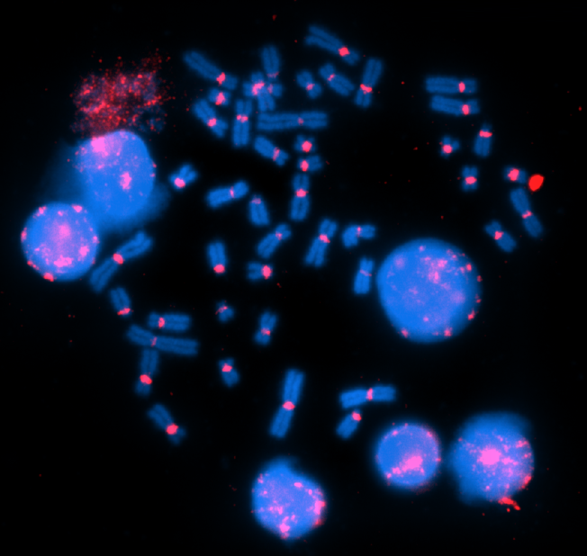
Human Genome Project and Bioinformatics Design
Human PanCEP Probe
Probe design which targets repetitive DNA within all human centromeres at once.
Applications
Assaying ploidy
Detecting acentric and multi-centric chromosomes
Qualification of spatial distribution of centromeres within nuclei
Human PanCEP probe (red) hybridized in human control metaphase spread and interphase nuclei.
www.kromatid.com
Notes:
Now let’s look at some custom designs.
Our pan-centromere probe targets all human centromeres at once in both metaphase and interphase cells.
Researchers whose work includes ploidy assays, and projects requiring tracking the position of centromeres in chromosomes and within the nuclei can benefit from KromaTiD’s panCEP probe.

Slide 17
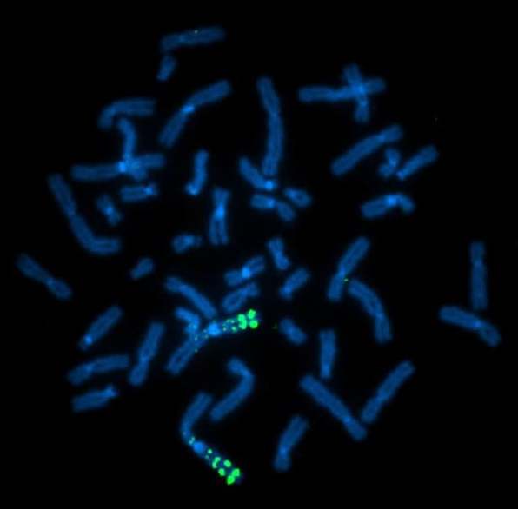
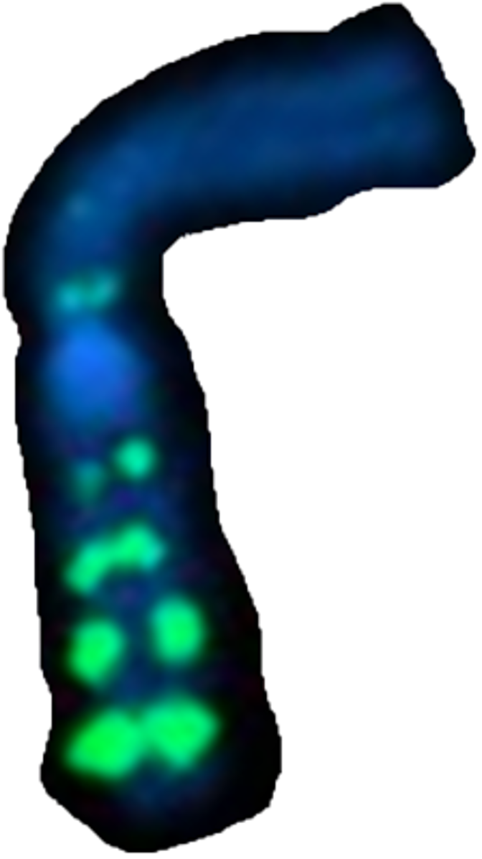
Custom Probe: Chromosome 1 Ladder
Chromosome 1 LOD Ladder
Evenly spaced loci targeted by probe sets comprised of progressively fewer probe molecules.
Applications
Troubleshooting elements of FISH assay
Sample quality
Individual protocol steps
Reagent preparation
Imaging hardware problems
Chr 1
LOD ladder
Chromosome 1 LOD ladder (green) hybridized in human control metaphase spread.
www.kromatid.com
Notes:
This is the chromosome 1 limit of detection ladder.
It can be used for troubleshooting many aspects of a FISH assay.
Whereas the bright region on the bottom is targeted by thousands of probe molecules, each probe spot above it has progressively fewer and fewer.
Poor samples, incorrectly made solutions, even problems with imaging hardware will result in fewer of the weaker signals being visible.

Slide 18
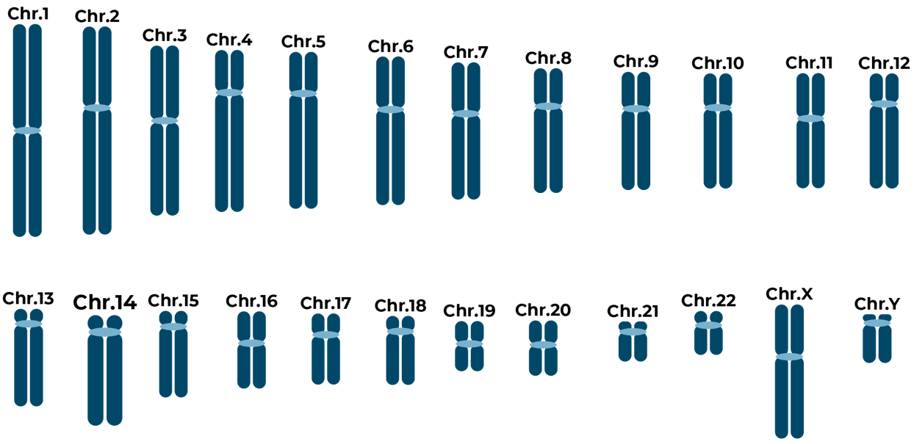
Custom Probe Design Parameters
The design process itself can be customized to accommodate specific challenges.
Control for sequences with calculated level of off-target affinity | Use target-site probe density to threshold-out stray signals during imaging
Accept off-target binding on known chromosome(s) | Manually remove problem sequences in case-by-case fashion.
www.kromatid.com
Notes:
When designing probes in challenging genomic regions or within difficult limitations, it may be necessary to venture beyond standard design parameters.
Target binding strength, risk of off-target signals, or the density of probes per kilobase can all be modulated with quality control precautions.
An assay which might not have been possible with other methods can be created by KromaTiD’s bioinformatics team.

Slide 19
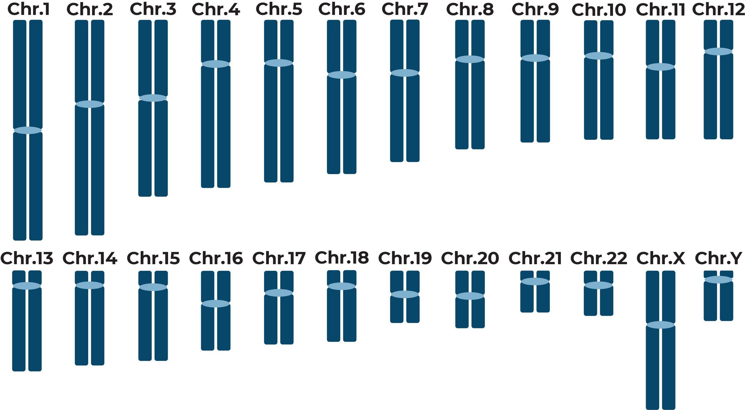
Tailoring Designs around Assay Goals
Assay Customization Options
Inclusion of companion marker probes
Modulation of fluorescence intensity
Arranging target loci strategically
Chr13
Hypothetical Custom Chr13 Deletion Sub-Categorization Assay:
ING1 (10.7 kb) chr13: 110,713,700-110,723,339
PRECSIT (6.3 kb) chr13: 110,863,987-110,870,307
Chr13 Reference Probe chr13: 25,191,642-27,410,224
Homology Marker Probe chr9: 97,523,005-99,819,022
ING1
PRECSIT
140 kb
www.kromatid.com
Notes:
Challenging limitations sometimes accompany custom design requests in which a broader, multi-component assay is required.
This hypothetical design is for a fictional user who needs chromosome 13 rearrangement data.
For her two neighboring genes of interest, ING1 and PRECSIT, she simultaneously needs to know when they are deleted and when they are split up by a translocation.
They are both smaller than 11 kb, which would normally require the labeling of a lot of the flanking space around them, risking false-negative outcomes.
Thanks to the high signal-to-noise ratio of synthetic oligo probes, custom KromaTiD probes can create a functional assay by making use of an adjacent reference signal and a homology marker probe on chromosome 9.
Respectively, these serve to confirm deletions and to rule out false, off-target signals, maintaining high data confidence for two challenging targets.

Slide 20
Pinpoint FISH™ Services
You and your team can have KromaTiD run your custom assay as an in-house service.
Beneficial for assay designs involving:
Very small probes,
Difficult sample types,
Complex sample conditions.
Also helpful if you are:
Lacking specialized equipment,
Without in-house expertise,
Desiring efficient turn-around time.
www.kromatid.com
Notes:
Those who would prefer to have KromaTiD take care of both the design and the execution of the assay have that option.
This can be preferable for especially challenging experimental designs, or if other circumstances make it impractical for researchers to run the assay themselves.
The investigator can define the final report elements in advance and count on timely delivery per those specifications.

Slide 21
Pinpoint FISH™ Services
1
2
3
4
5
Identify target and scope
Probe design and assay proposal
Design approval and sample shipment
Assay execution and data analysis
Data review and discussion
Example workflow with KromaTiD running Pinpoint FISH or alternative assays in-house.
KromaTiD is committed to collaborative excellence through dedicated project management and
expert technical analysis.
Your role
KromaTiD’s role
Collaborative
www.kromatid.com
Notes:
This graphic showcases the typical phases of our in-house service projects with roles broken out according to the legend at the bottom-right.
KromaTiD needs a detailed understanding of the project’s goals, then designs the assay around that before seeking approval from the contracting scientific team.
If approved, that party ships their samples to us and we take care of the probe manufacturing, benchwork, imaging and analysis.
The last stage is the data review and delivery of final reports.

Slide 22
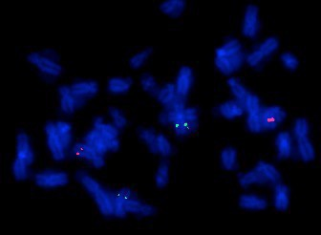
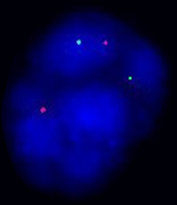
Example Service Assay: CUX1 and KIF20A
Metaphase spread and interphase nucleus hybridized with custom probes for CUX1 (green; 0.5 Megabases) and KIF20A (red; 8.6 kilobases)
www.kromatid.com
Notes:
This is an example of a service assay KromaTiD performed in house, targeting the CUX1 and KIF20A genes.
Those interested in a similar in-house service assay start by supplying written details of their desired design, such as the loci of interest, species, and sample specifics.
Members of KromaTiD’s senior science team then meet remotely with the scientist to confirm the design, execution and reporting details before work begins.

Slide 23
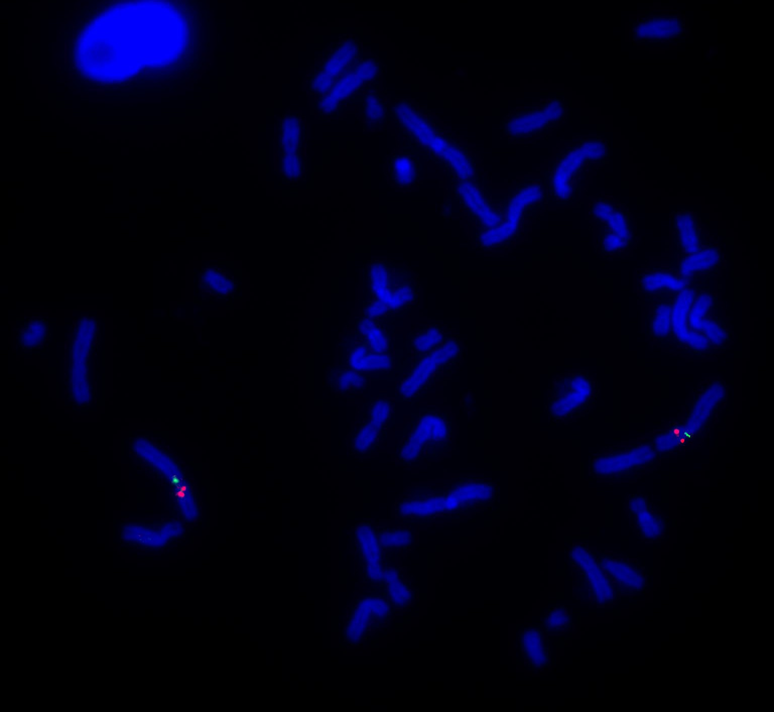
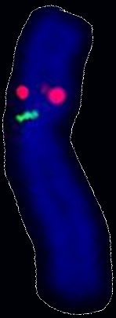
Example Service Assay: DCTN1 Multiplex with Commercial Probe
KromaTiD custom probe for DCTN1 (red; 30 kilobases) and third-party control probe (green; 170 kilobases)
www.kromatid.com
Notes:
In this example, the custom KromaTiD design labeled in red is hybridized in combination with a commercial BAC probe labeled in green.
Thanks to the QC controls early in the sequence selection process for synthetic oligo probes, they have little difficulty performing in combination assays like this one.

Slide 24
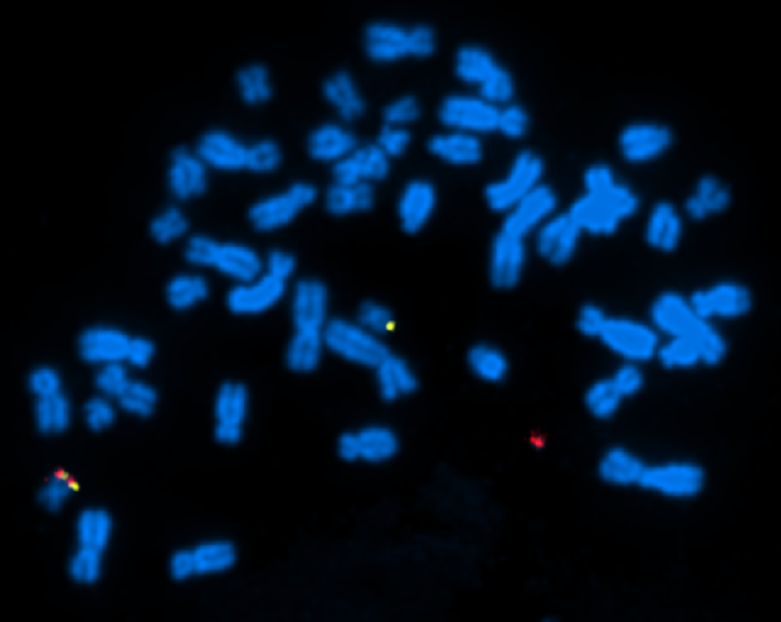
Example Service Assay: CAR-T Structural Rearrangement Assay
Chr 19
Rearranged copy Chr19
Normal copy Chr19
AAVS1 edit site
Probes designed to bracket AAVS1 edit site
Yellow probe: proximal from target site
Red probe: distal from target site
Metaphase spread showing AAVS1 edit site rearrangement detected by KromaTiD custom probe set
www.kromatid.com
Notes:
This metaphase spread is hybridized with a pair of custom KromaTiD probes flanking a gene-editing target site.
The CAR-T engineering experiment has triggered a rearrangement, as highlighted by the separation of the two colors in the center two circles.

Slide 25
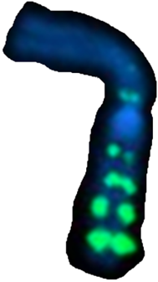
Standard Color Label Options and Custom Configuration
Five standard color labels
Custom labeling available
Probe concentrations: standard, custom or dehydrated
Probes can be pre-combined
Color Label | Excitation λ | Emission λ
Atto 425 (aqua) | 436 | 485
6-FAM (green) | 490 | 525
Atto 550 (orange) | 555 | 576
Texas Red (red) | 595 | 620
Atto 643 (far red) | 643 | 669
www.kromatid.com
Notes:
KromaTiD can manufacture all probe products in five standard colors, but custom labeling is also offered.
Researchers can request probes be
dehydrated,
concentrated to a specific volume per assay,
or prepared in specific combinations.

Slide 26
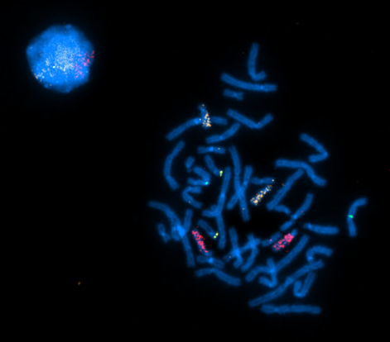
Ordering Pinpoint FISH™
We provide convenient ordering online of all our catalog probes.
Visit https://kromatid.com and click on FISH Probes from our menu.
Credit Cards Accepted | Purchase Orders Accepted
For custom services or probes, ordering can be done from any of the FISH
probe pages on our website, by clicking the “Request a Quote” button.
TECHNICAL SUPPORT:
LIVE CHAT: M-F 9 AM- 5 PM MT
EMAIL: TECHSUPPORT@KROMATID.COM
INQUIRIES AND ORDERS:
EMAIL: SALES@KROMATID.COM
WEB: KROMATID.COM
Ph: 720.815.2898
Fx: 720.815.2902
Your local sales representative can discuss your fluorescent labeling needs and any specific experimental requirements.
www.kromatid.com
Notes:
You can initiate an order on the KromaTiD website – kromatid.com.
Orders can be placed either with a credit card or a purchase order.
For custom designs, your local sales representative can initiate the discussion about your project needs, and setup a meeting with KromaTiD’s senior science team.

Slide 27
Q & A
Questions? Contact Us Today!
www.kromatid.com

