Slide 1
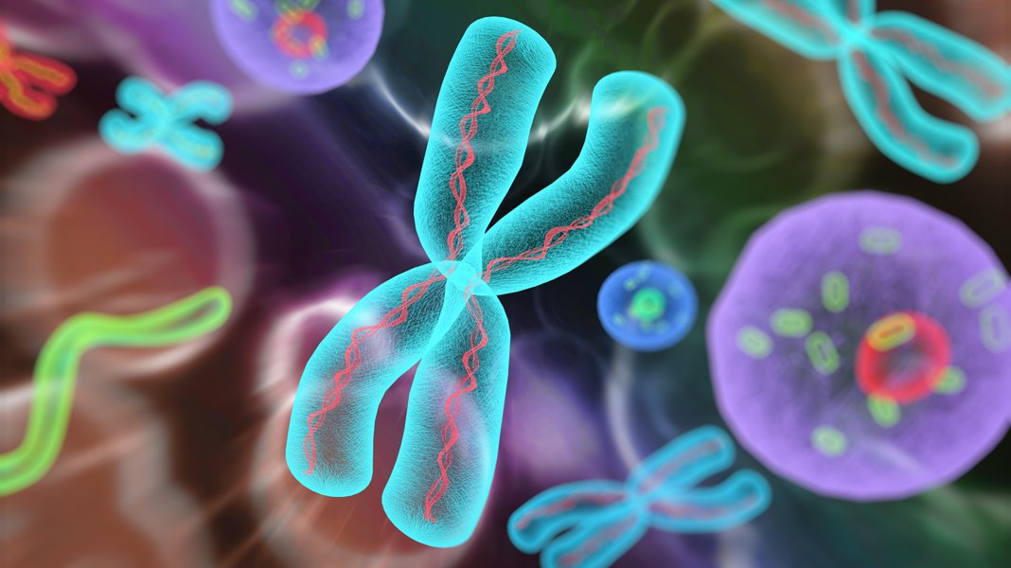
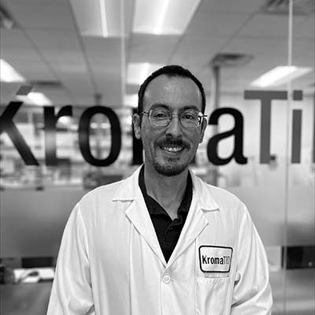
Uncovering Structural Variants Missed by Conventional Cytogenetic Techniques
KromaTiD Overview
Cytogenetics Techniques and Contrast with dGH
Introduction to the dGH Assay Suite
Hypotheticals: Analysis of Cell, of Sample, of Sample Set
Value of Orthogonal Data and the Role of dGH
Presented by Ivan Perez | Technical Applications Scientist, KromaTiD
Notes:
Thank you, Stephanie. I would like to personally welcome all of you to this discussion.
In this presentation, I am pleased to introduce KromaTiD, and to review how to gather the most complete picture possible of genomic changes in your samples.
We’ll look at several well-established analysis options, then we’ll place KromaTiD’s dGH assays within that context.
Three different lenses will help put this into focus: analysis of a single, very abnormal cell, analysis of a mosaic sample, and analysis of a sample set.
We’ll then close-out by looking at how orthogonal datasets can plug gaps through which critical pieces of information may otherwise slip by.

Slide 2
Overview of KromaTiD
KromaTiD is staffed by a committed team specializing in delivering top-tier genomic tools and services.
Located in Longmont, Colorado, our primary mission is to offer the tools and assistance required to propel the progress of genomic medicine and research.
www.kromatid.com
Notes:
KromaTiD is based in Longmont, Colorado, just outside of Boulder.
We are a research-focused team committed to providing top-tier tools, service, and expertise to advance scientific progress.
We work with scientists in academic institutions, in large pharmaceutical companies, and within governmental settings.

Slide 3
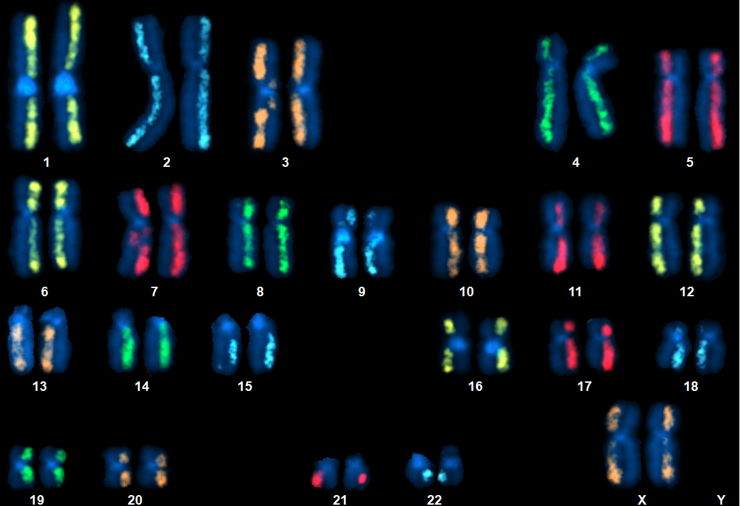
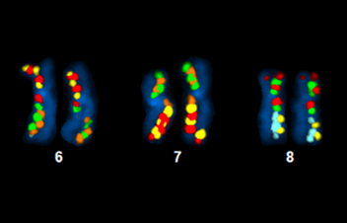
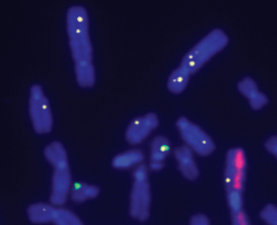
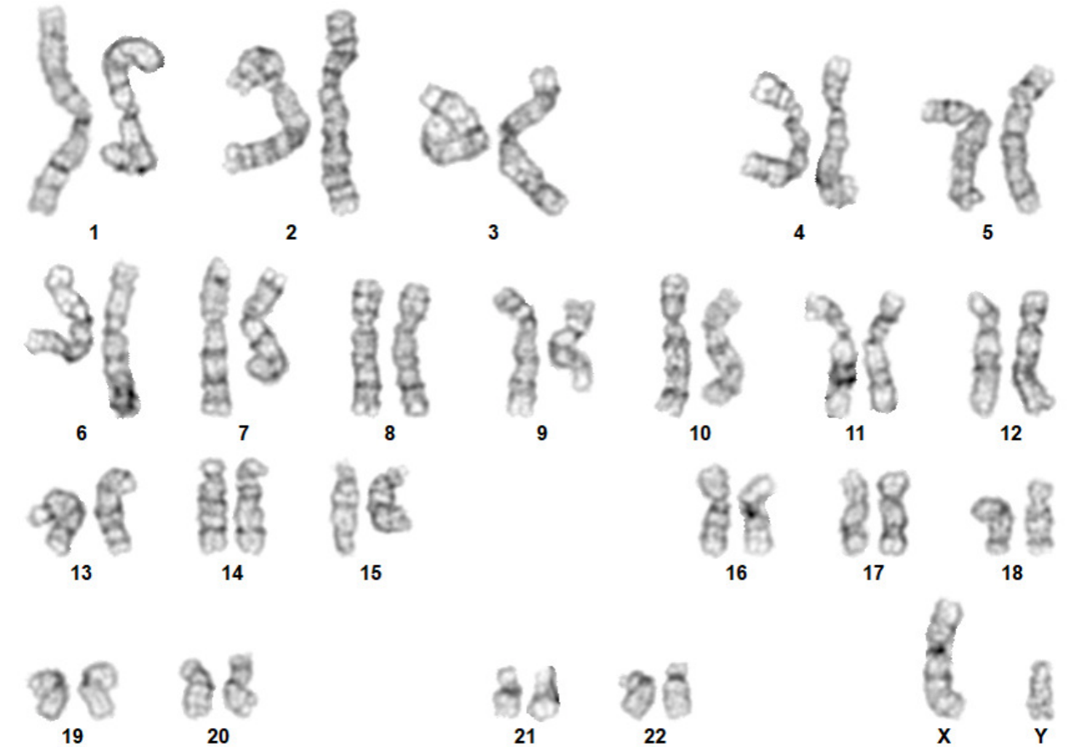
dGH: Powerful, High-Resolution Cytogenomic Solutions
dGH SCREEN
dGH DSCVR
dGH in-Site
G-Banding
Unmatched insights into
Gene editing outcomes
Genomic integrity
Biomarkers of disease
www.kromatid.com
Notes:
KromaTiD supports the scientific community with a wide range of genomics tools and methods.
These include custom probes, genomic integrity G-banding, and a sophisticated set of proprietary assays, which we’ll look at shortly.

Slide 4
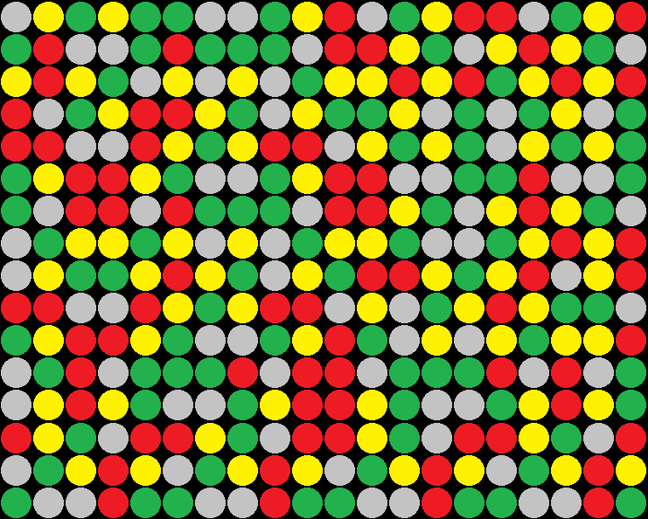
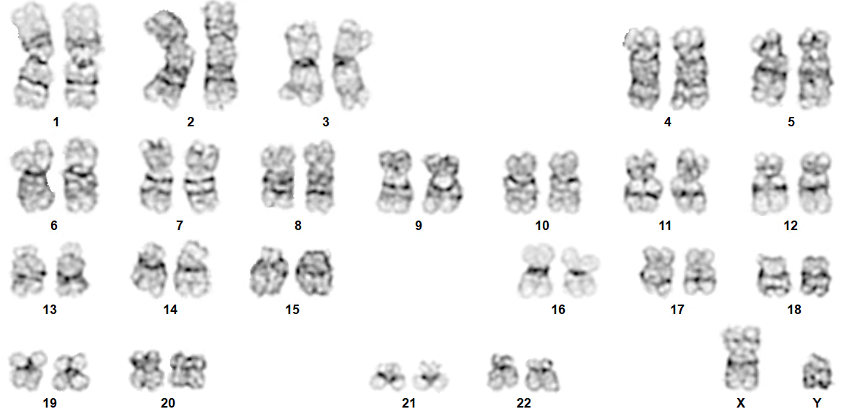
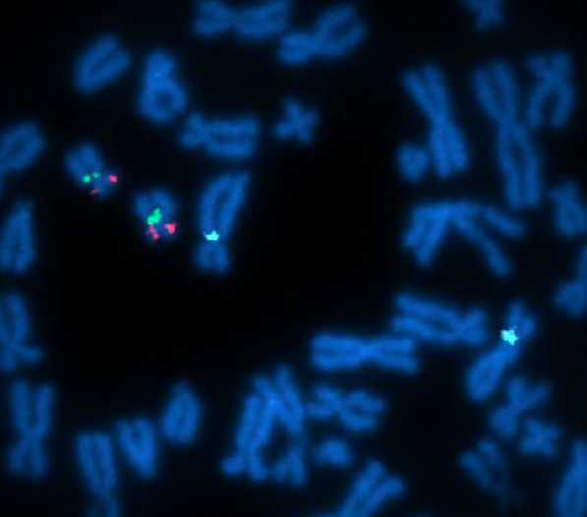
Established Cytogenetic Methods
aCGH
G-Banding
FISH
www.kromatid.com
Notes:
Let’s now take a high-level look at some of the most widely-used cytogenetic methods.
Array-based comparative genetic hybridization (aCGH or array CGH) places DNA from lysed cells on a glass slide which has DNA probes immobilized onto it in a grid pattern.
The sample DNA and probe DNA are each labeled in a different color, which enables estimation of copy-number differences based on the ratio of fluorescence wavelengths.
G-banding relies on staining differences between chromosomal regions which are relatively AT-rich or GC-rich, looking at one cell at a time.
The signature banding patterns allow identification of chromosome segments down to approximately 10 Mb, enabling characterization of complex genomic changes.
Lastly, fluorescence in situ hybridization (FISH) is hybridization-based, like microarray, but is almost always run on whole, single cells.
Fluorescently-labeled probes bind to complementary sequences on sample nucleotide molecules, permitting strategic, multiplex designs for targeting specific loci or entire chromosomes.

Slide 5
Fluorescence In Situ Hybridization (FISH)
Double-stranded
FISH probe
Denatured sample and probe DNA bind. Slide proceeds to post-hybridization wash and imaging.
Cells alive
in culture
Cells swollen
and fixed
Metaphase spreads adhered to slide
Sample and probe DNA now in contact
Probe and coverslip
applied
Sample
drop
Heat
applied
Harvest
w w w . k r o m a t i d . c o m
Notes:
Of the techniques discussed, FISH, specifically metaphase FISH is most similar to dGH and can serve as a starting point.
Metaphase FISH begins with live cells in culture.
Not long before culture harvest, cells are exposed to a mitotic blocker, such as colcemid, which stops dividing cells from progressing past metaphase in the cell cycle.
Cells are next “dropped” onto glass slides where many of them will lyse, spilling their contents.
Controlled ambient conditions cause those lysed cells to form “metaphase spreads.”
Labeled probes are applied to the slide.
If the sample nucleotides are DNA, heat and formamide may be used for denaturation.
Probe DNA strands will then have access to anneal at their target sites and be detected via fluorescence.

Slide 6
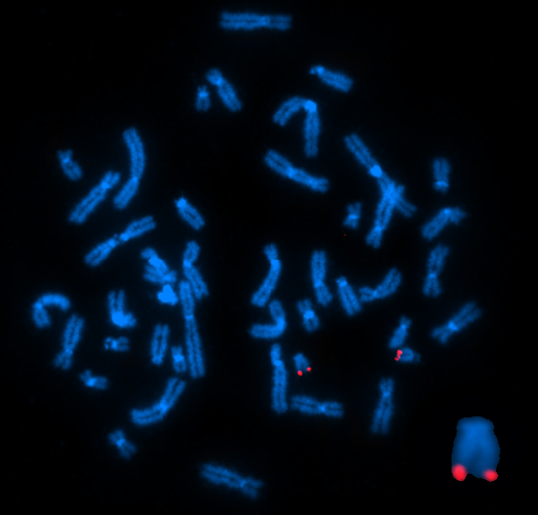
Example FISH Image
Example of FISH hybridization outcome.
Fluorescence is seen in the subtelomeric region of the q-arm of chromosome 21.
The corresponding target site on each of the two chromatids fluoresces with its own signal.
w w w . k r o m a t i d . c o m
Notes:
In this example FISH hybridization image, the probes target next to the telomeric repeat sequences of the chromosome 21 q-arm.
Each of the two chromosome 21 homologs is composed of two chromatids, and each chromatid bears a fluorescent signal at the probe set’s target locus.

Slide 7
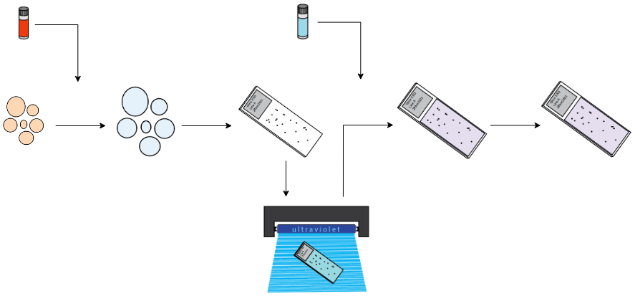
Directional Genomic Hybridization (dGH)
dGH media additive
Probe targeting
only one strand
Denatured sample and probe DNA bind. Slide proceeds to post-hybridization wash and imaging.
Cells swollen
and fixed
Metaphase spreads adhered to slide
Sample and probe DNA now in contact
Cells alive
in culture
Probe and coverslip
applied
Sample
drop
Heat
applied
Harvest
Slide UV irradiated; daughter-strands degraded by exonuclease
w w w . k r o m a t i d . c o m
Notes:
The basic FISH assay is the backbone of the directional Genomic Hybridization (dGH) method, as can be seen in the similar workflow.
As in FISH, the first step has cells in culture, but analog nucleotides are added to the culture medium before cell-cycle arrest.
The cells will incorporate the analog nucleotides as they synthesize new DNA strands in preparation for division.
Those analog-substituted daughter-strands will be damaged upon later exposure to UV light and degraded by exonuclease leaving each chromatid with only a parent-strand.
The probe applied to the sample targets either the negative or positive parent-strand, but not both as in FISH.

Slide 8
Directional Genomic Hybridization (dGH)
Probe targeting only one strand
Denatured sample and probe DNA bind. Slide proceeds to post-hybridization wash and imaging.
dGH media
additive
Cells swollen
and fixed
Metaphase spreads adhered to slide
Sample and probe DNA now in contact
Cells alive
in culture
Probe and coverslip
applied
Sample
drop
Heat
applied
Harvest
UV irradiation; exonuclease exposure
w w w . k r o m a t i d . c o m
Notes:
These are the three principal steps at which dGH differs from FISH.
Analog nucleotides are added to the culture medium, substituted strands are exposed to UV and exonuclease to degrade them, and probes targeting only one strand are applied to the sample.
The rest of the steps resemble a typical FISH assay.

Slide 9
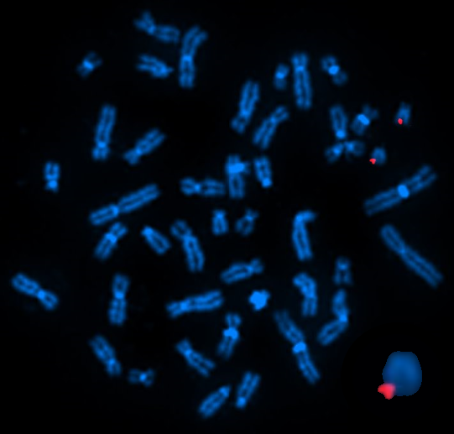
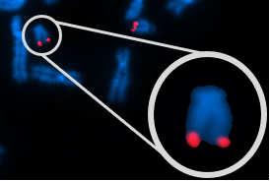
Example dGH Image
Example of dGH hybridization outcome.
Fluorescence is seen in the same subtelomeric region of chromosome 21
as with FISH, but now the chromosome has only one target site.
Only one chromatid has DNA complementary to the probe sequences.
Previous FISH example.
w w w . k r o m a t i d . c o m
Notes:
The larger figure on the left shows an example image of a dGH hybridization
It uses the same chromosome 21 subtelomere probe set as before, which can be seen in the bottom-right image.
To summarize, a dGH hybridization requires both the sample and the probe set to be single-stranded.
Sample DNA must lack daughter-strands, and probe molecules must target one of the parent-strands, not both.

Slide 10
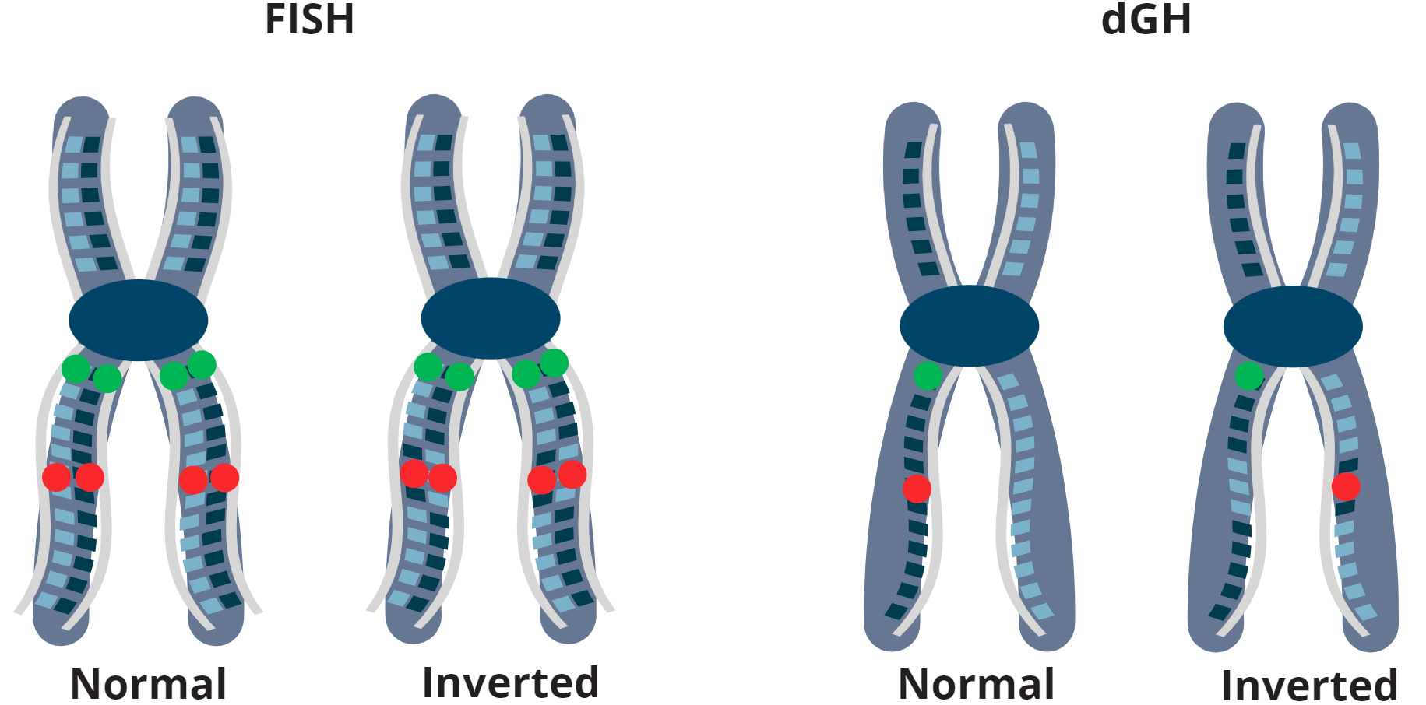
Inversions and dGH
Side-by-Side
FISH
dGH
www.kromatid.com
Notes:
To illustrate the signal pattern difference with dGH, we’ll first look at the two pairs of chromosomes in the graphic.
The pair on the left underwent a FISH reaction, and the pair on the right underwent dGH.
In each pair of chromosomes, the right-hand one has experienced a small inversion.
In the FISH reaction, this produces no change in signal pattern because both DNA strands are present and bound by probes.
However, the single-stranded dGH example shows that, while the green probe hasn’t changed, the red signal is now on the opposite chromatid.
In the side-by-side on the right, both chromosomes have an inversion in the p-arm, but the green paint probe just covers everything in the FISH reaction.
Only dGH shows some of the fluorescence having followed its target DNA onto the left-hand chromatid.

Slide 11
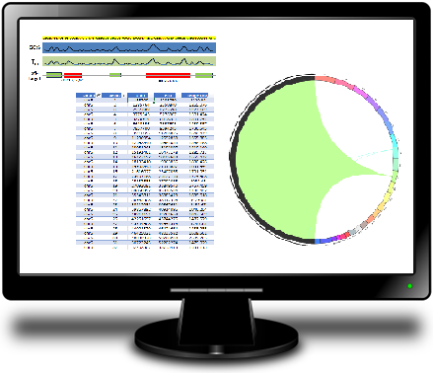
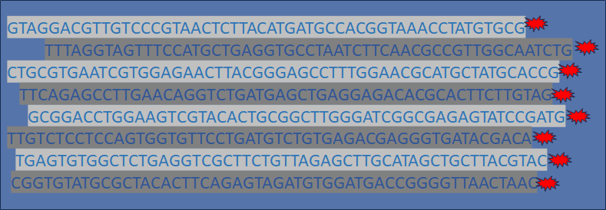
Manufacturing Process for KromaTiD Probes
In Silico Design
Fluorescently Labeled Oligonucleotides
Selected sequences are synthesized, amplified and fluorescently labeled.
QC testing ensures clean probe performance.
www.kromatid.com
Notes:
Making single-stranded dGH probes starts with bioinformatics.
Traditionally, FISH probe sets have been created using bacterial artificial chromosome (BAC) libraries, resulting in double-stranded probes.
For dGH, bioinformatic sequence selection happens in silico.
Candidate probe sequences with off-target complementarity or problematic binding characteristics are screened out from the start.
Ideal sequences, all targeting one strand only, are then manufactured synthetically and fluorescently labeled.
This production process means no repetitive DNA blocking agent, such as Cot-1 is required.
The maximized signal-to-noise ratio enables targeting of loci orders of magnitude smaller than with many BAC-based FISH probes.

Slide 12
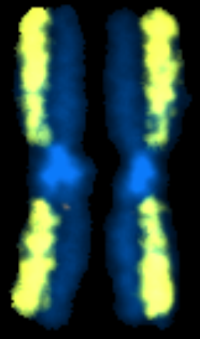
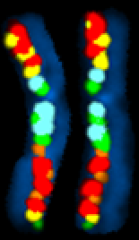
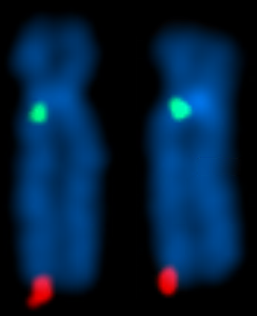
The dGH Assay Suite: SCREEN, DSCVR, in-Site
dGH SCREEN
dGH DSCVR
dGH in-Site
www.kromatid.com
Notes:
Next, we can look at the three primary dGH tools: SCREEN, DSCVR and in-Site.
All three generate single-cell data through direct visualization.
Together, they enable the user to calibrate data from completely unbiased to highly targeted, depending on experimental needs.

Slide 13
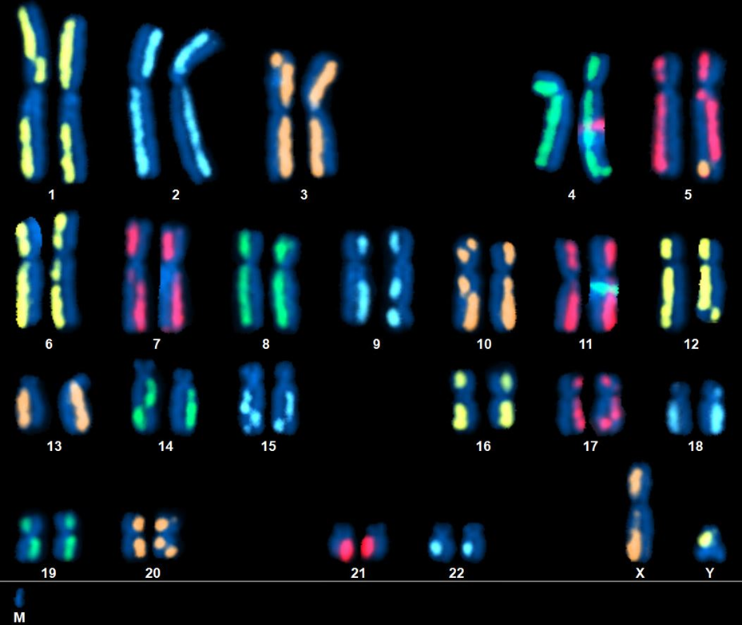
dGH SCREEN
Features of dGH SCREEN:
Whole-genome, unbiased
Single-cell
Direct visualization
Rearrangements detected include small inversions
Lower Limit of Detection (LLOD) as low as 10 kb
www.kromatid.com
Notes:
In SCREEN, the entire chromosome set is targeted at once.
The single-cell nature of the images means variant data exists in the context of whatever else is happening in that specific cell.
Abnormalities are confirmed through direct visualization.
SCREEN can measure all rearrangement types detectable by FISH, array CGH, or G-band analysis, including small inversions.
Depending on local probe coverage, the lower limit of detection for SCREEN can be as low as 10 kilobases.
This means even those rearrangements traditionally described as cryptic can be picked up.

Slide 14
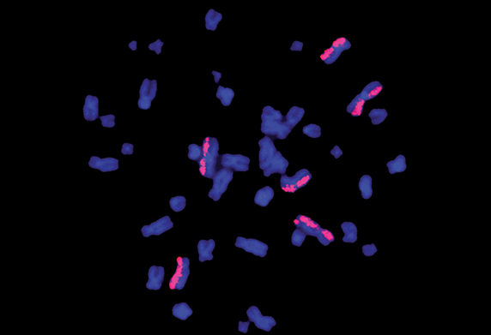
Use Case: NASA ”Twin’s Study” HD Chromosome Paints
KromaTiD work with NASA in the “Twins Study”
Assay of DNA damage from radiation in Space.
KromaTiD continues to work with NASA.
Fluorescent Paints Spot DNA Damage from Radiation, Gene Editing. (2019). Retrieved from https://spinoff.nasa.gov/Spinoff2019/hm_3.html
www.kromatid.com
Notes:
One exciting application of SCREEN paints is the role KromaTiD played as part of the NASA Twins Study.
Identical twin astronauts, Scott and Mark Kelly were studied over the course of one year while one was in orbit and the other was here on Earth’s surface.
NASA scientists needed a better way to track DNA damage suffered through exposure to the ionizing radiation of Space.
The dGH paints enabled the space agency to compare the frequency of structural rearrangements and other changes seen in the DNA of both subjects.
KromaTiD continues to work with NASA, in collaboration with Dr. Susan Bailey at Colorado State University.

Slide 15
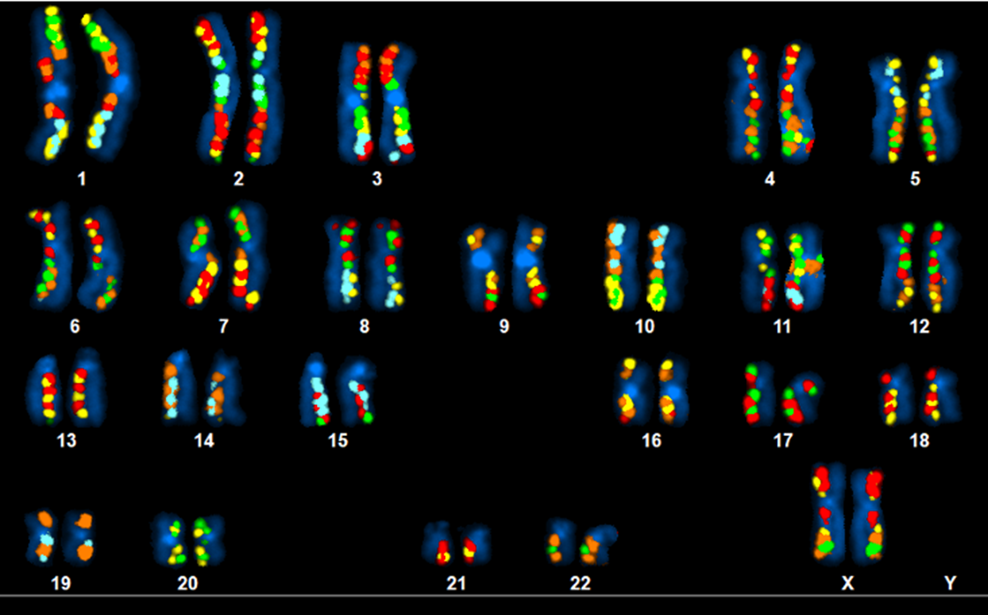
dGH DSCVR
Features of dGH DSCVR:
Unbiased within locus-of-interest
Detects all rearrangements affecting that region
Bands are one to a few Mb
LLOD same as SCREEN
www.kromatid.com
Notes:
This is the banding pattern you’d see with DSCVR if it were applied to the whole genome, though it is generally applied in a more localized fashion.
Within the region being targeted, this assay is unbiased, detecting all rearrangements present there.
Breakpoints can usually be localized to within a single megabase, or even less depending on proximity to a band junction.
The lower limit of detection is equal to that for SCREEN.
DSCVR is a powerful tool for projects seeking biomarker discovery or target validation, such as with cancer or rare diseases.

Slide 16
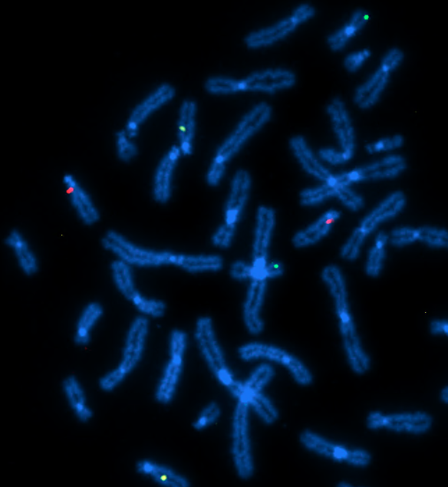
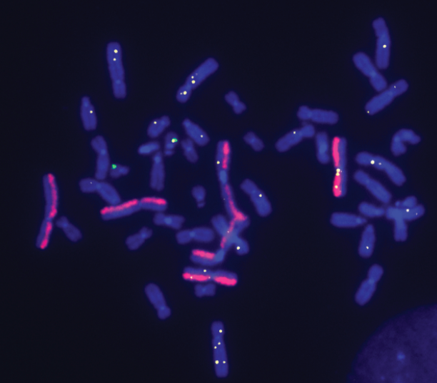
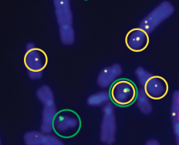
dGH in-Site
Left vs Right Chromatid =
Insert Orientation
Yellow =
Off-Target Insert
Green =
Target Site
Yellow-on-Green =
On-Target Insert
www.kromatid.com
Notes:
dGH in-Site assays generate locus-specific data, down to a resolution as low as 2 kilobases.
In the image on the left, three high-value CAR-T engineering targets are measured at once.
Keep in mind that while these may look like simple enumeration probes, each dGH in-Site probe is an enumeration, break apart and dual-color dual-fusion probe simultaneously.
The image on the right is a three-color assay used to measure the outcome of a gene editing experiment.
The assay simultaneously measures background genomic instability, insertions per cell, location and orientation of inserts, and insertion-related structural rearrangements.

Slide 17
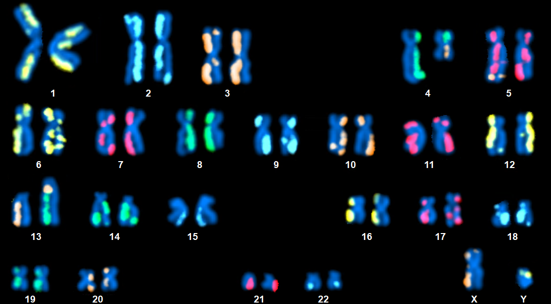
Hypothetical Scenario: Composite Karyogram
www.kromatid.com
Notes:
A complex abnormal cell such as this one can represent a serious challenge to many assays.
Array CGH generates gain-and-loss data, so it wouldn’t detect balanced translocations.
G-banding would be very hard-pressed to catch small insertions, as well as several of the small inversions present.
Sequencing could be used to detect very small variants.
However, data quality depends on the specific sequencing platform, read depth, and alignment algorithm, especially in highly repetitive regions.
Without any bioinformatic intermediate step like sequence alignment, dGH enables direct, visual confirmation of data.

Slide 18
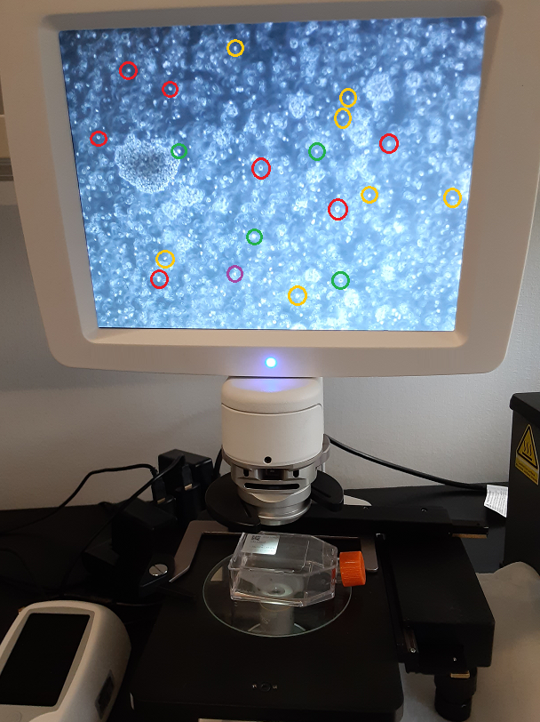
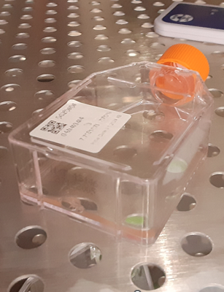
Hypothetical Scenario: Mosaic Sample
Multiple Clones within One Sample:
Clone A; 47% of cells
Insertion at all three target sites
Translocation triggered between two insertion loci
Clone B; 41% of cells
Insertion at all three target sites
Insert sequence duplicated in 2 of 3
Clone C; 11% of cells
Insertion at one of three target sites
Insertion is in inverted orientation
Delete of tumor-suppressor gene
Clone D; 1% of cells
Subclone of Clone C, has multiple tumor suppressor knock-outs via off-target structural rearrangements
www.kromatid.com
Notes:
Having just looked at a single, very abnormal cell, let’s turn to an example of the value of high-throughput dGH.
Here is a poly-clonal sample in which each clone has a different set of editing outcomes, but clones C and D have experienced tumor-suppressor gene deletions.
Clone D, being a very low-prevalence population at 1% of the total, represents a serious risk to patients.
The high cell-count, yet single-cell data generated by dGH assays enable direct detection of small populations such as in this case.

Slide 19
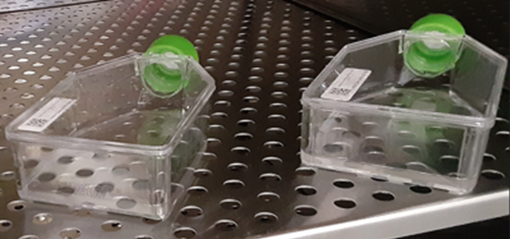
Hypothetical Scenario: Heterogeneous Sample Sets
Comparing Editing Techniques
Comparing Donors
Comparing Culture Conditions or Editing Components
Comparing Conditions Over Time
www.kromatid.com
Notes:
One of the benefits of sample sets is that variants detected may enable inferences about potential sources of abnormalities.
The ability of dGH assays to generate data on genomic stability and insertional outcomes through direct visualization makes the technology ideal for this application.
Reliable data derived from sample sets enables comparison of all aspects of an editing project.
Donor samples may be compared against each other, the impact of various culture conditions and components of the editing method itself can be tested.
The impact these variables may have on genomic stability can also be measured over different timepoints.
Valuable inferences may be derived about potential sources of changes to chromosomal structure with direct, single-cell visualization.

Slide 20
Orthogonal Data
G-Band Karyotyping
Unbiased | Single Cell, Heterozygosity Data
Gross Structural Changes | Lower Resolution, Approximately 10 Mb
dGH SCREEN
Unbiased, Sequence-Orientation Data | Single Cell, Heterozygosity Data
Rearrangements, Small Inversions Included | Higher Resolution, as Low as 10 kb
dGH in-Site
Targeted, Sequence-Orientation Data | Single Cell, Heterozygosity Data
Tracks Inserts, Target Site Rearrangements | Can Achieve Resolution Below 2 kb
Targeted NGS
Targeted Sequencing at Loci of Concern | Mingled DNA Strands from Multiple Cells
Accuracy/Bias Are Platform-Dependent | Base Pair-Level Resolution
www.kromatid.com
Notes:
Orthogonal data refers to information gathered through analysis of the same subject via unrelated methods.
In this analysis sequence, samples are assayed via G-Banding first, as it targets the whole genome of single cells in an unbiased way and is relatively inexpensive.
Subsequent analysis by dGH SCREEN -- also single-cell, unbiased and whole-genome, offers a higher-resolution orthogonal comparison to the G-Banding data.
dGH in-Site may then be performed on target loci identified by the unbiased assays.
The high resolution of in-Site can locate sequences as small as 2 kb, and reveal structural changes like inversions within those sites.
Lastly, sequencing can then be targeted to loci of concern, generating results which can be compared against existing data.

Slide 21
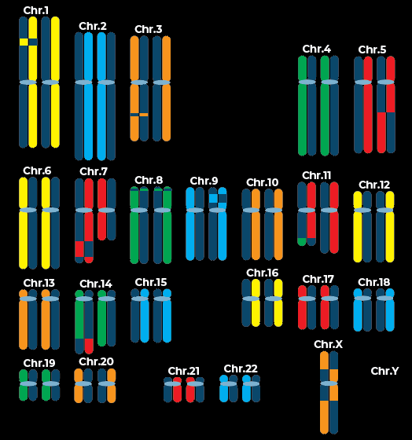
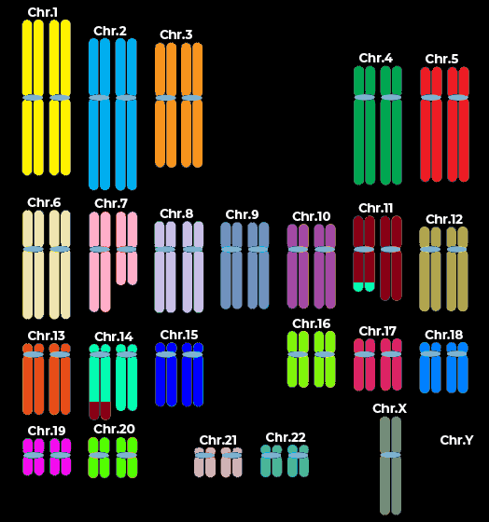
Other Multicolored Karyotyping Techniques
dGH SCREEN
Spectral Karyotyping
www.kromatid.com
Notes:
Some techniques generate images which bear a striking resemblance to dGH assays, but let’s look at how dGH data is completely different.
Here are dGH SCREEN on the left, and Spectral Karyotyping, or SKY on the right.
If we look at SCREEN first, we see twelve white arrows, each indicating an abnormality.
These include aneuploidies, deletions, a translocation, inversions and sister-chromatid exchanges.
In the SKY karyogram, eight out of twelve of those arrows, two-thirds are red because SKY detects nothing abnormal there.
They indicate data which has been left on the table by not using dGH.
Which genes have been affected by those rearrangements? How will they impact patient safety, and regulatory approval?

Slide 22
The Role of dGH
www.kromatid.com
Notes:
Here is a SCREEN image we saw earlier.
If SKY alone were used, only the three rearrangements indicated by yellow arrows would be detected.
Being based on FISH and labeling both strands at once, rearrangements that don’t change chromosome size, number, or arm length go unnoticed.
While a FISH break apart probe might be designed to catch individual inversions, that requires knowing in advance where the rearrangement will take place.
Conversely, all the dGH assays are unbiased in the sense that they detect whatever is happening within the targeted area, be it a whole chromosome or a 2 kilobase insert.

Slide 23
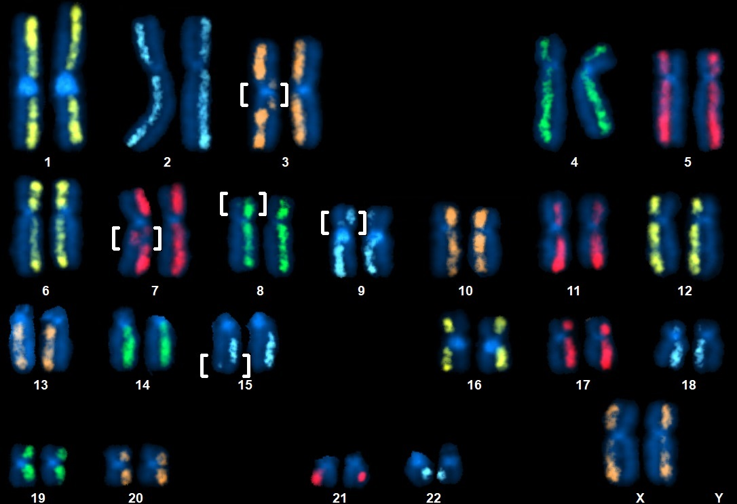
The Role of dGH
Left vs Right Chromatid =
Insert Orientation
Yellow =
Off-Target Insert
Green =
Target Site
Yellow-on-Green =
On-Target Insert
www.kromatid.com
Notes:
Established cytogenetic methods enjoy wide-spread use, but many other technologies, such as sequencing platforms offer valuable data.
They vary in cost, technical expertise required, how laborious or time-consuming each assay is, their reproducibility, and excluded sample types.
However, dGH technology offers a unique view of the genome.
dGH data is based on single cells, the data output can be whole-genome or locus-specific to the degree required, and results are based on direct visualization.
Critically, the single-stranded targeting approach enables detection of rearrangement types not picked up by many other methods, especially at high resolution.
These features make dGH assays an excellent option as a stand-alone suite, or as a source of comparative, confirmatory data alongside other platforms.
KromaTiD’s senior science team collaborates with labs to craft the best analytical strategy, making the most of all available tools and data to accelerate scientific progress.

Slide 24
Q & A
Questions? Contact Us Today!
www.kromatid.com
Notes:
At this point, Erin Cross, Vice President of R&D and myself would like to welcome any questions you may have.

